Slide 1

Some of my best friends use spreadsheets
Notes:
Give some background with respect to your day-to-day job
For better or for worse, a lot of the data I receive in the form of spreadsheets
A lot of these are very difficult to import into R quickly in a ready to analyse way

Slide 2
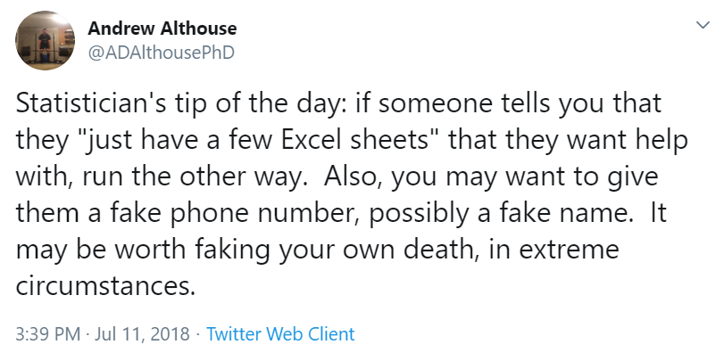
Notes:
Spreadsheets allow you to corall a bunch of disparate things
All these things in one place, and what feels like all in one file.
The spreadsheets are reactive, when you update the data the calculations update, the figures update

Slide 3

“Data import is 80% boredom,
20% endless screaming”
- Hadley Wickham
Chief Scientist, RStudio
Notes:
Part of the problem is you go into data analysis with the tools you know or that are available to you, not the tools you need

Slide 4
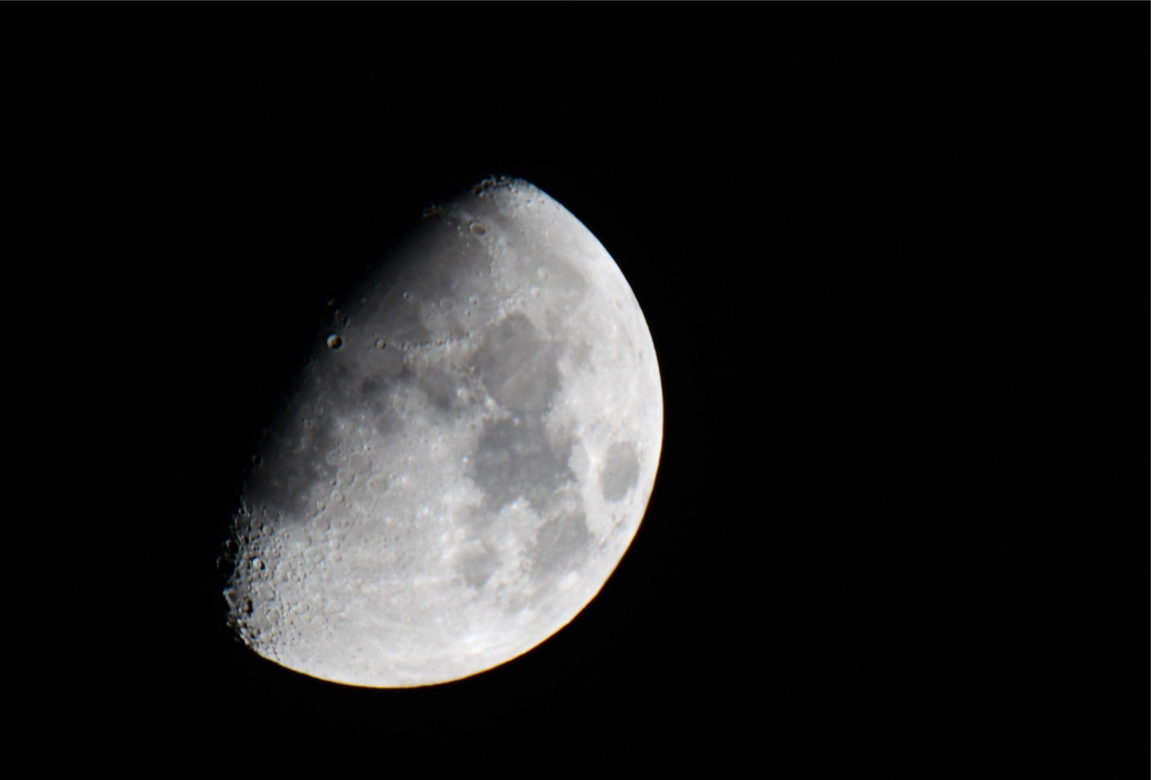
Spreadsheets:
A dystopian moonscape of unrecorded user
actions
- Jenny Bryan
Notes:
Those of us who do scripted analyses tend to vent on spreadsheets a lot
We can’t explain everything that happened or how it got to be the way that it is
But I think people use spreadsheets for, may not resemble what they actually use them for

Slide 5
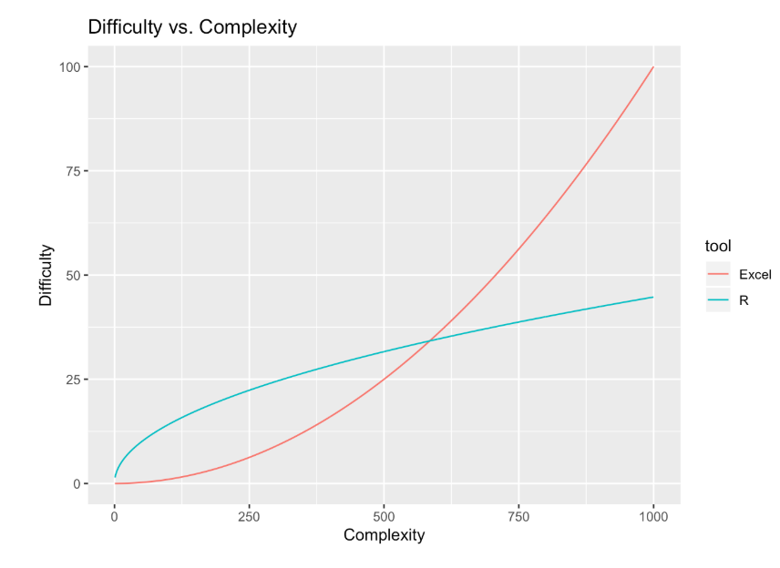
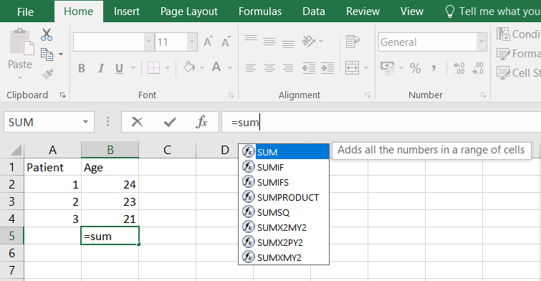
Excel is intuitive to use
Notes:
Spreadsheets are such a good programming system, that people can programme, without knowing they’re programming
It’s just so intuitive
People just know what to do and they can start doing it immediately
Spreadsheets are code
Spreadsheets are not just code, they are functional programming and reactive programming
Survey on StackOverflow of developers revealed that 80% of them were self taught programmers

Slide 6
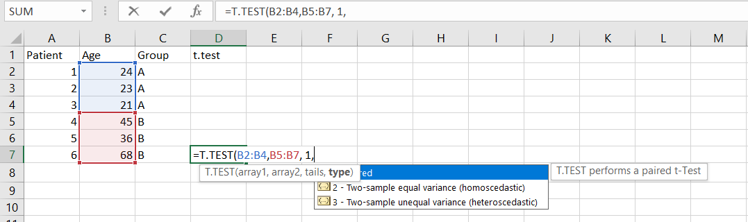
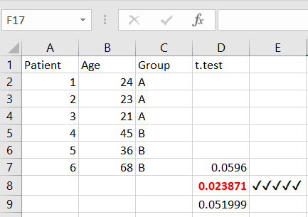
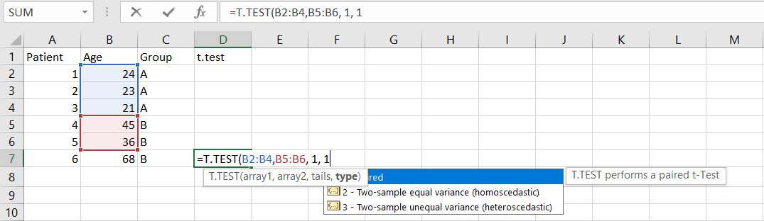
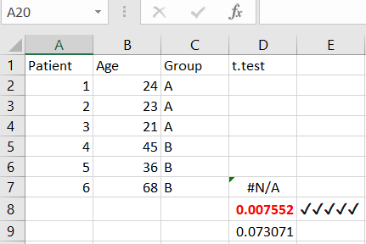
But a breeding ground for errors
Notes:
Spreadsheets are such a good programming system, that people can programme, without knowing they’re programming
It’s just so intuitive
People just know what to do and they can start doing it immediately
Spreadsheets are code
Spreadsheets are not just code, they are functional programming and reactive programming
Survey on StackOverflow of developers revealed that 80% of them were self taught programmers

Slide 7
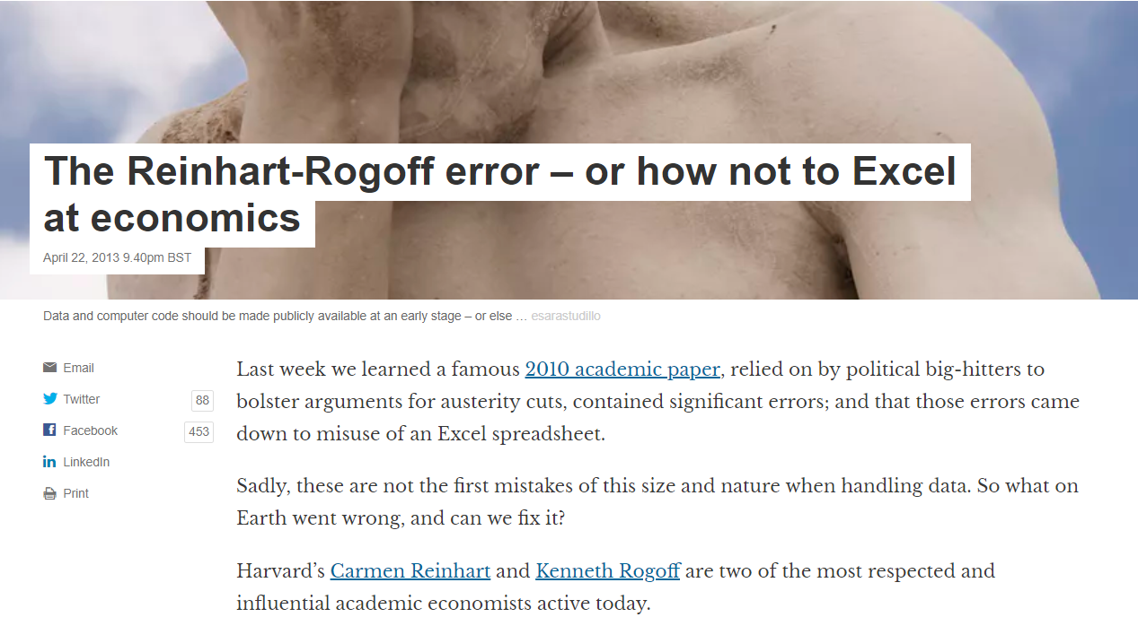
And mistakes can happen all too easily
Notes:
Reinhart and Rogoff’s work showed average real economic growth slows when a country’s debt rises to more than 90% of gross domestic product
The most serious was that, in their Excel spreadsheet, Reinhart and Rogoff had not selected the entire row when averaging growth figures: they omitted data from Australia, Austria, Belgium, Canada and Denmark.
In other words, they had accidentally only included 15 of the 20 countries under analysis in their key calculation.
When that error was corrected, the “0.1% decline” data became a 2.2% average increase in economic growth.

Slide 8
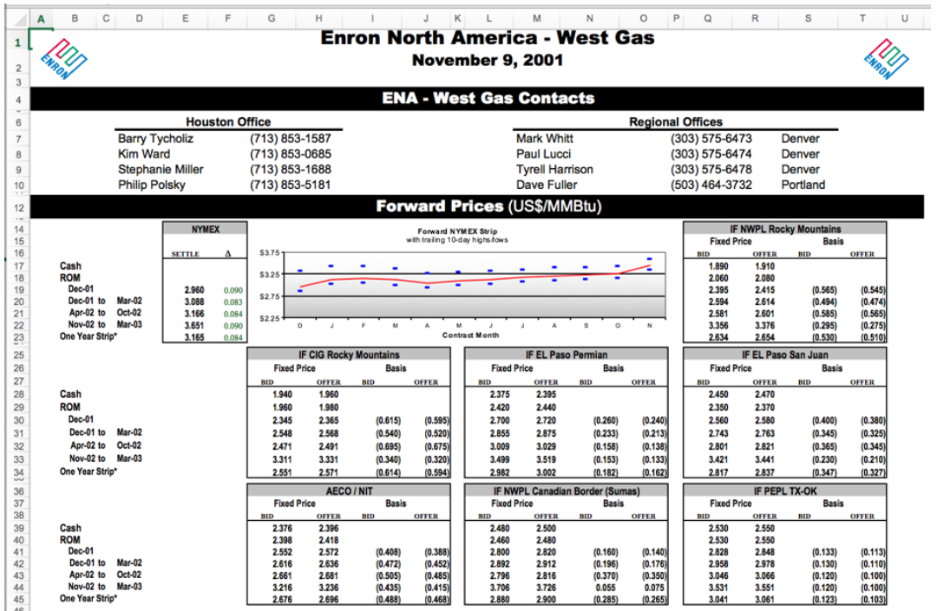
This is a big worldwide problem
Notes:
The ENRON corpus – American energy company
- by the use of accounting loopholes were able to hide billions of dollars in debt from failed deals and projects
600K emails and email have attachments and attachments contain spreadsheets
>15K spreadsheets

Slide 9
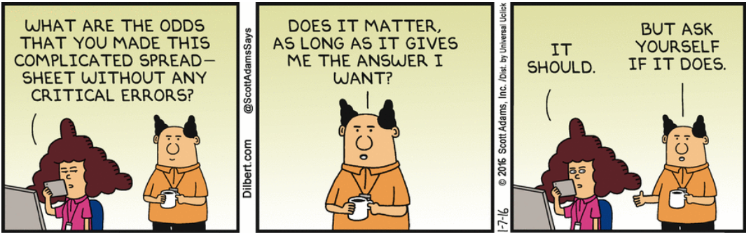
Notes:
Spreadsheet combine:
data
figures
formatted tables
+ reactivity

Slide 10
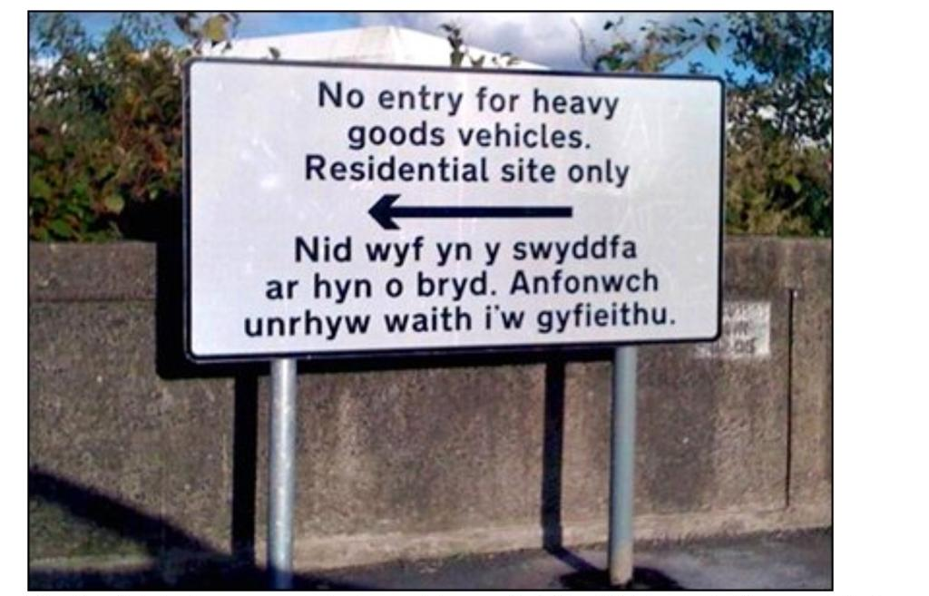
Fundamental problem – default settings
I’m not in the office at the moment. Send any work to be translated
Notes:
Increasingly we send our data off to be crunched by an algorithm. Do we use the returned result unquestionably?

Slide 11
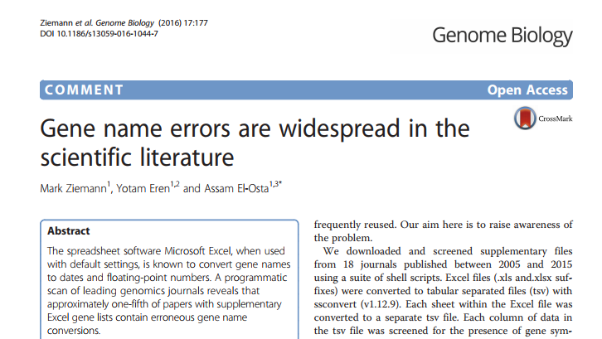
Beware of default settings
- Why did it take us until 2016 to discover this?
Notes:
How many times have you opened up an Excel worksheet and close it straight away yet get asked to save changes?
You might not have made any, but Excel sure did!
This applies to any software you use in the future

Slide 12
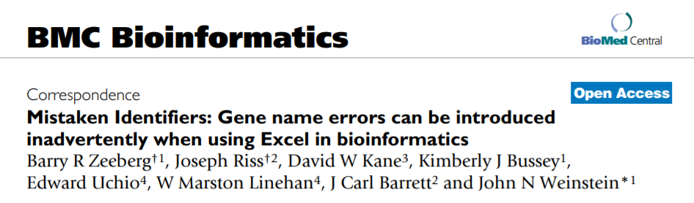
*cough* We’ve known for a long time *cough*
2004
Notes:
How many times have you opened up an Excel worksheet and close it straight away yet get asked to save changes?
You might not have made any, but Excel sure did!
This applies to any software you use in the future

Slide 13
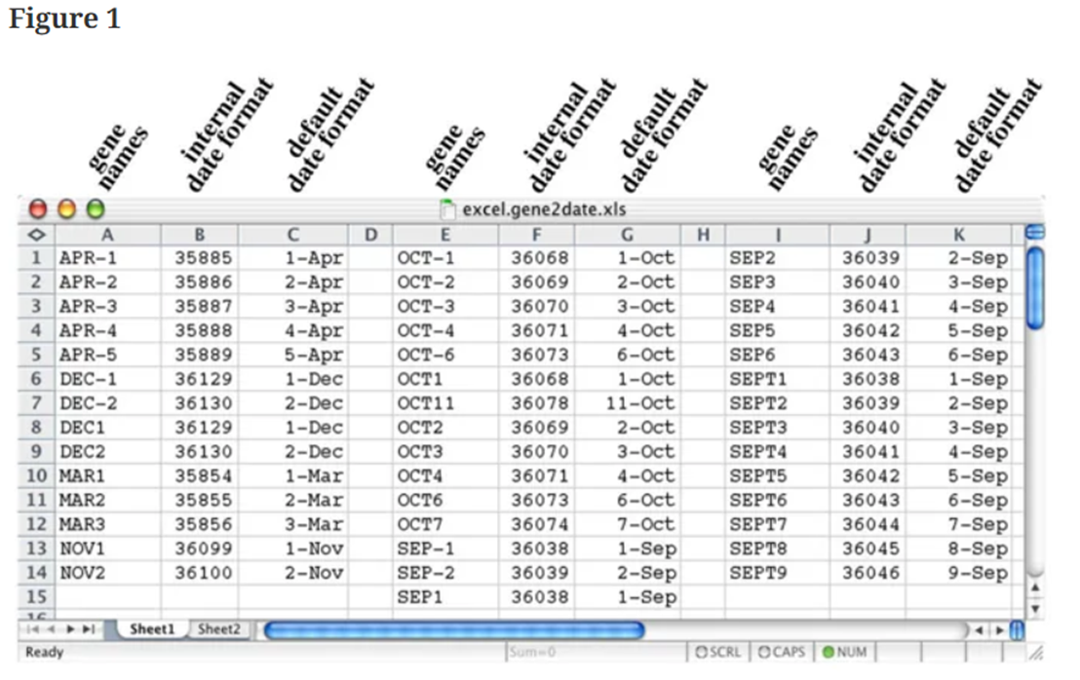
Notes:
Accidently use sort without selecting all the columns and you’ve inadvertently randomised the data……
Columns A, E, and I contain the correct gene names
Columns B, F, and J contain the corresponding underlying internal Excel date representation resulting from the forced default date conversion
Columns C, G, and K contain the corresponding default format date conversions

Slide 14
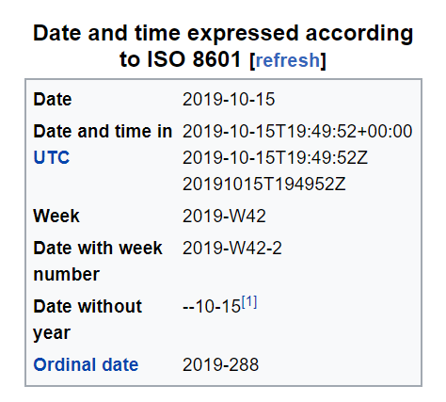
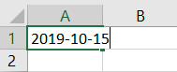
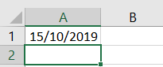
But it doesn’t end there
- YYYY-MM-DD or YYYYMMDD
- Type this into Excel
- And hit return
- DD/MM/YYYY

Slide 15
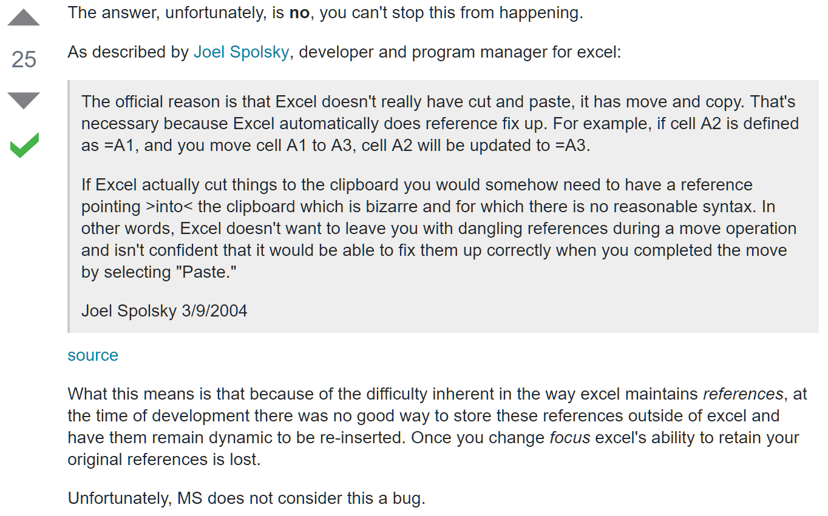
Excel also frequently gets clipboard amnesia
Notes:
I’m not having a go at people who use Excel
It’s more that I need to point out the potential issues with Excel

Slide 16
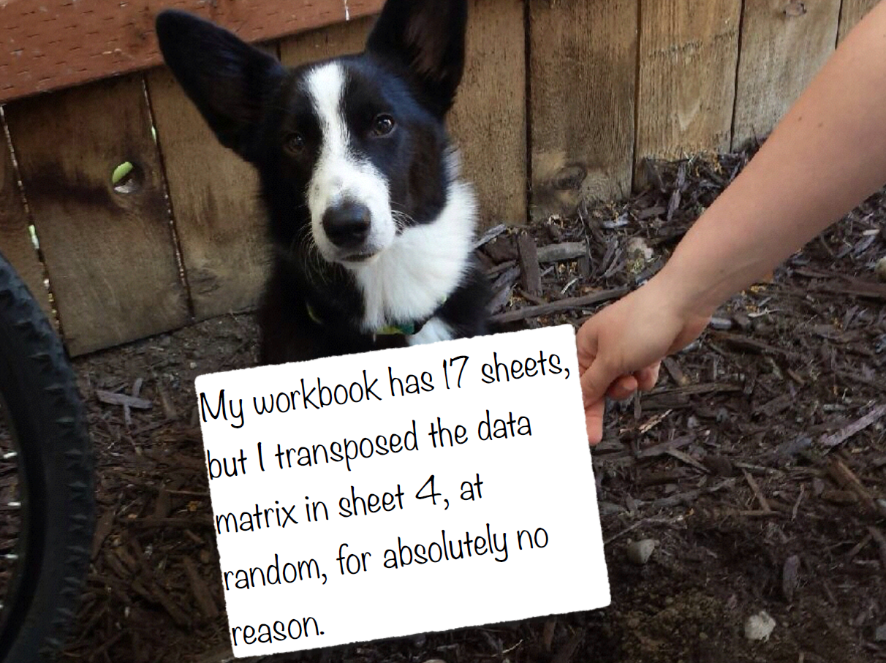

Slide 17
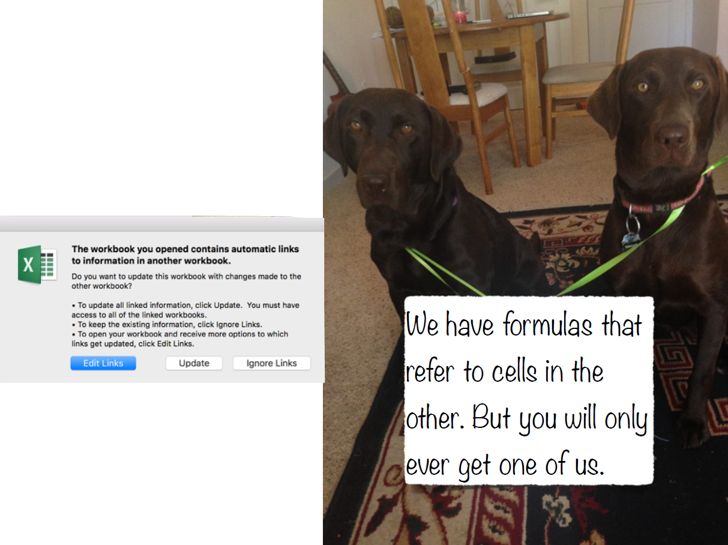

Slide 18
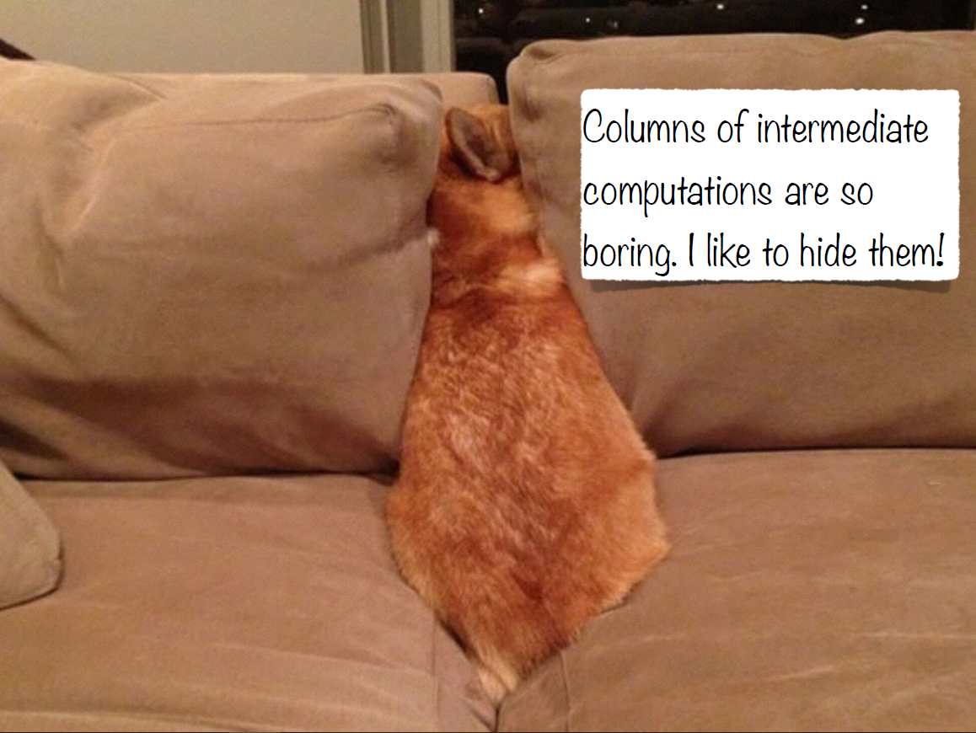

Slide 19
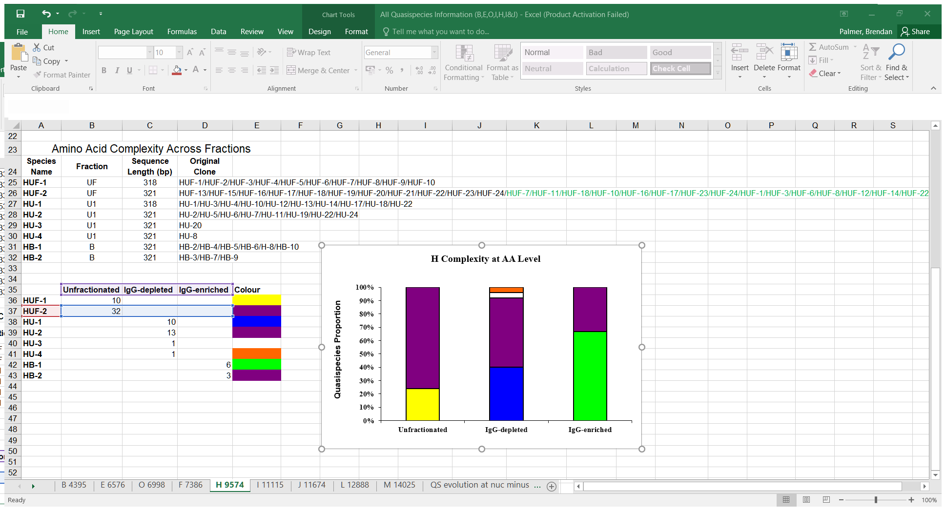

Slide 20
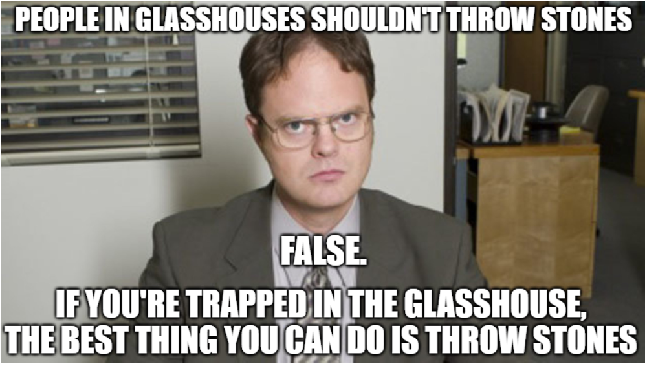

Slide 21
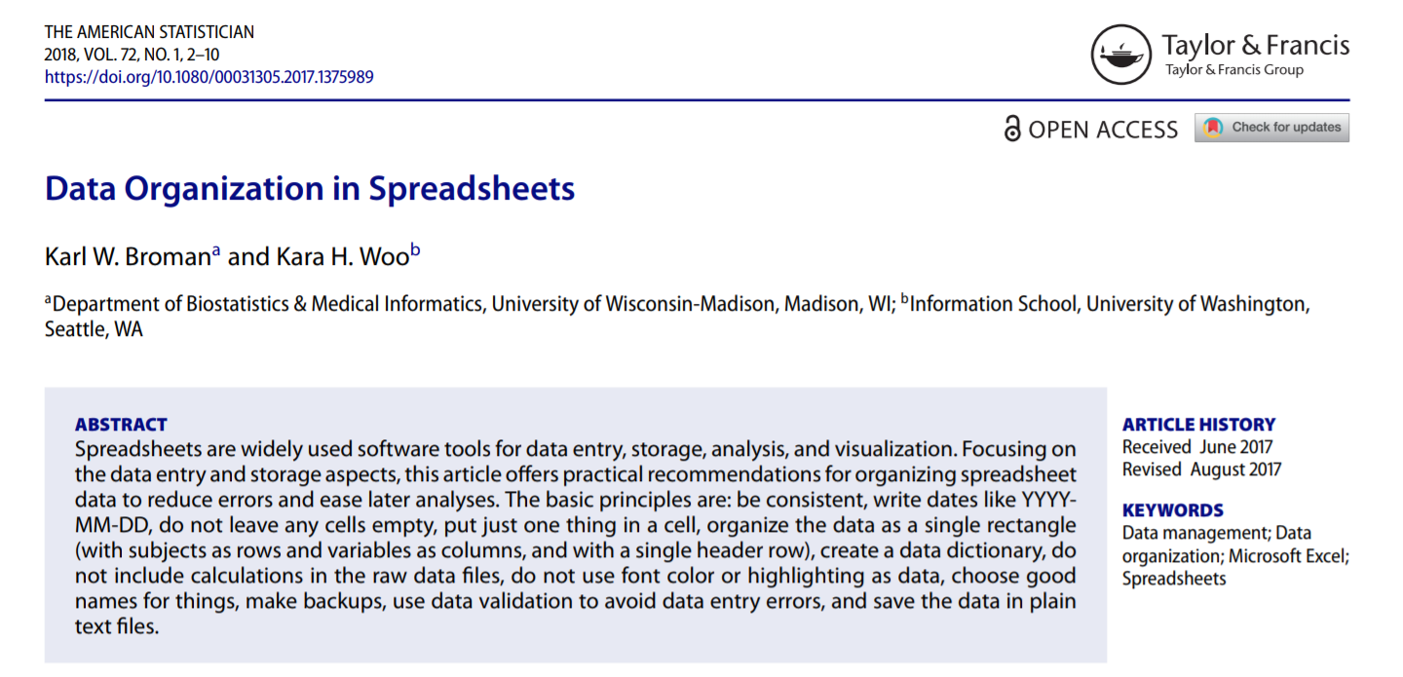
Take small steps to big changes
Notes:
Start reading from… The basic principles are…
Once you say the first one go to excel and enter a date

Slide 22
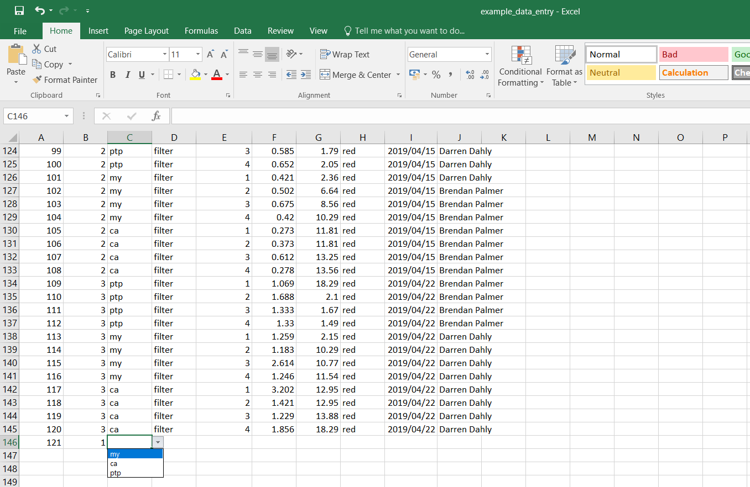
Less stress, more success
Notes:
This applies to any software you use in the future

Slide 23
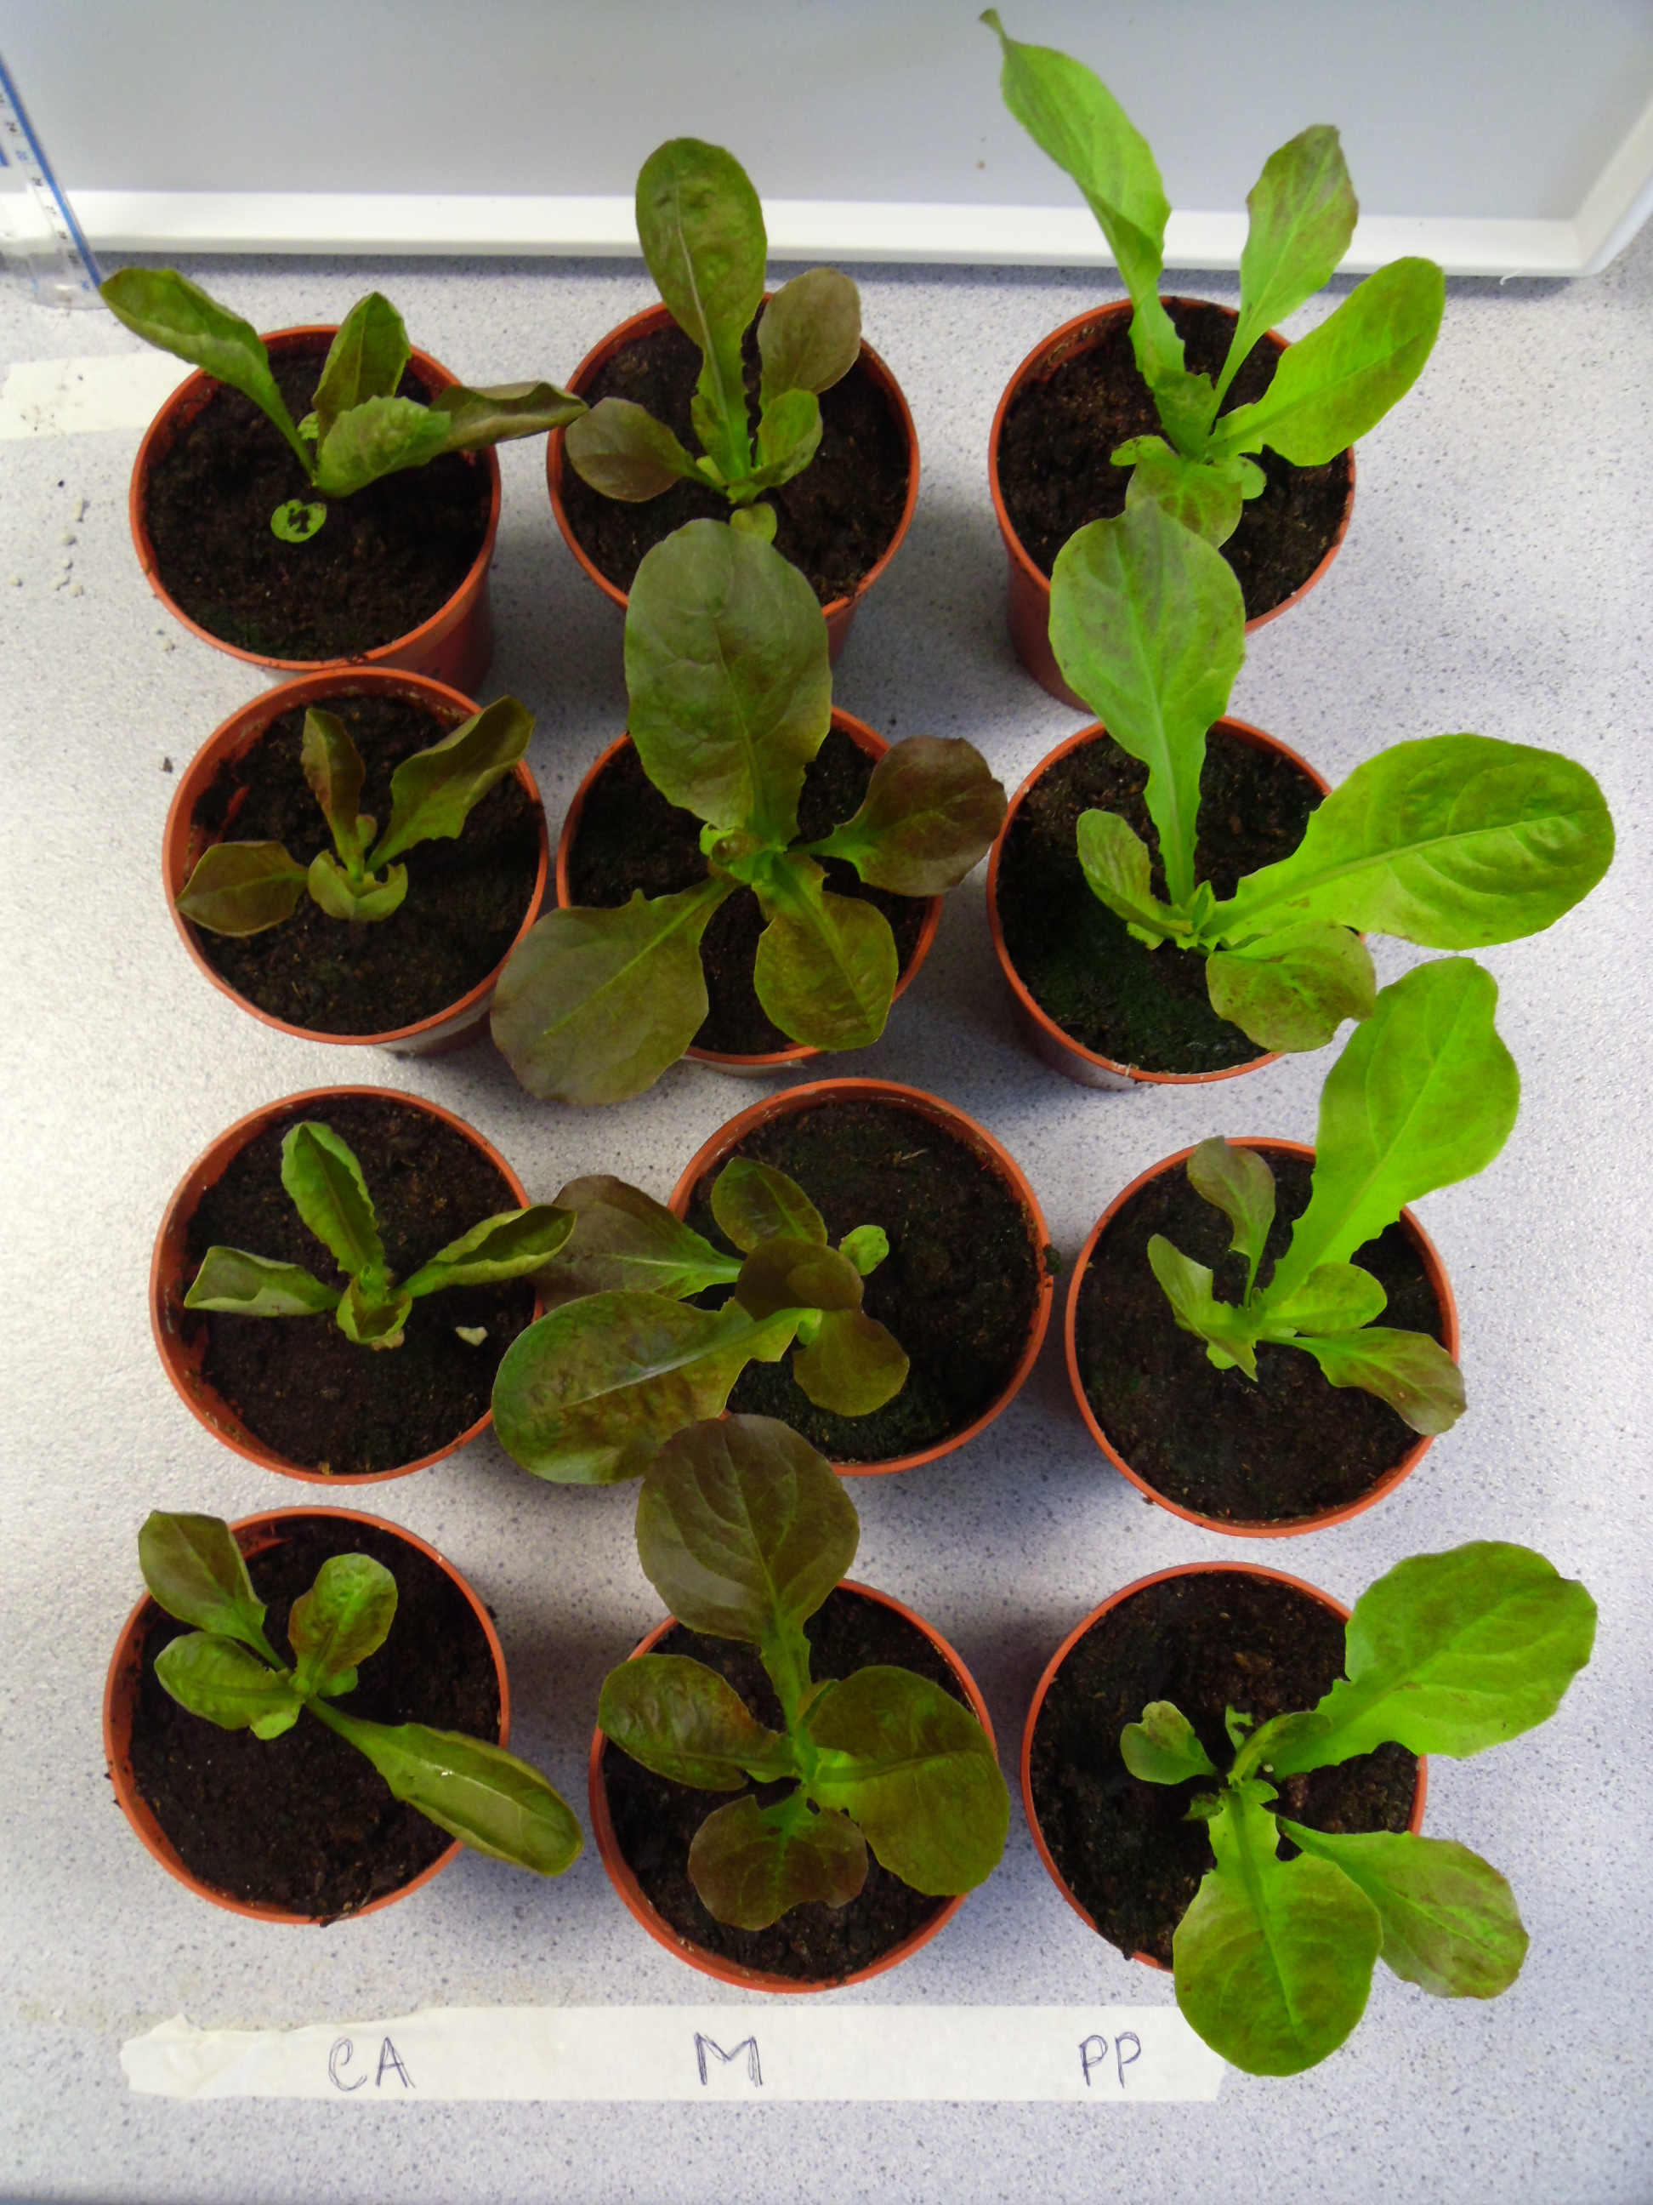
Our real life experiment…
UV light has potential to change the secondary metabolite composition (colour) of bronze/red lettuce
Experimental setup:
3 lettuce varieties
3 UV filter conditions
3 week duration
Full Light Spectrum
Just UVA
No UV

Slide 24
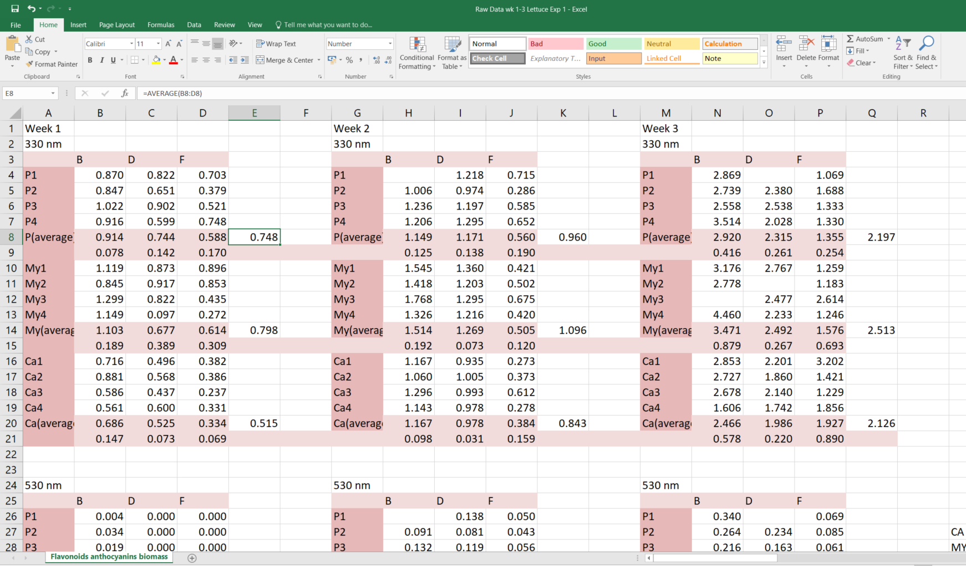

Real data comes with real problems
?
Notes:
Formulas within the data
Unlabelled data
Missing/blank data
Data in the formatting assists with human readability but not machine readability
Other problems include merged cells/columns

Slide 25
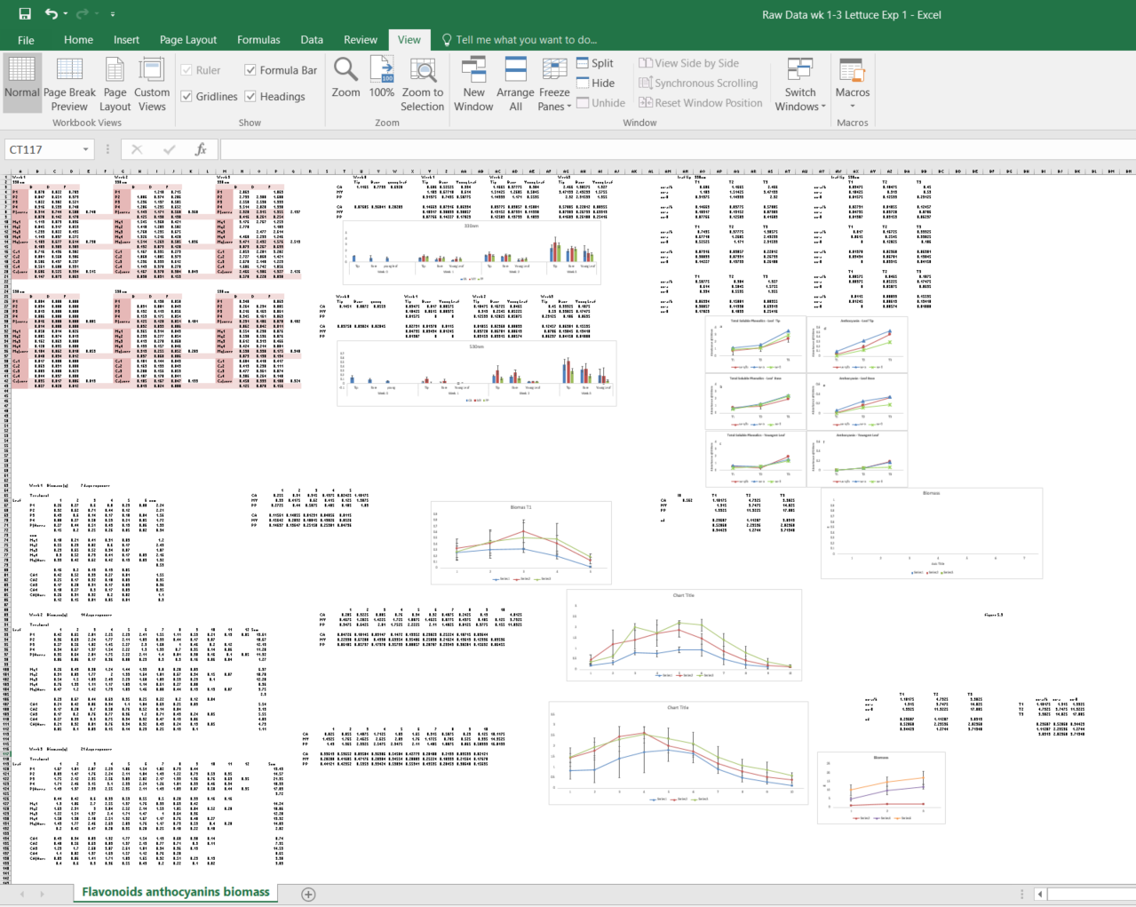

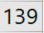

Slide 26
Notes:
Small multiples
Graphics

Slide 27
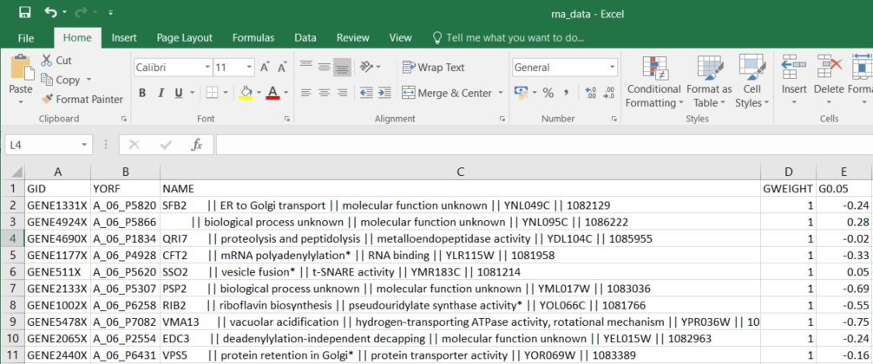
- Each variable forms a column
- Each observation forms a row
Notes:
Multiple data elements within cells

Slide 28
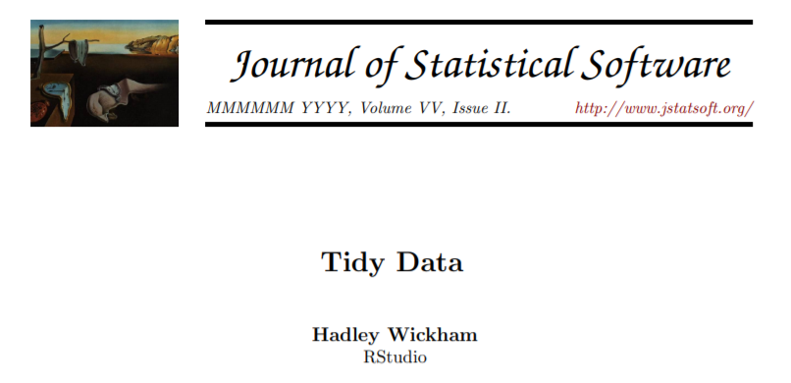
Tidy data is clean data
- Each variable forms a column
Each observation forms a row
Each cell contains a value

Slide 29
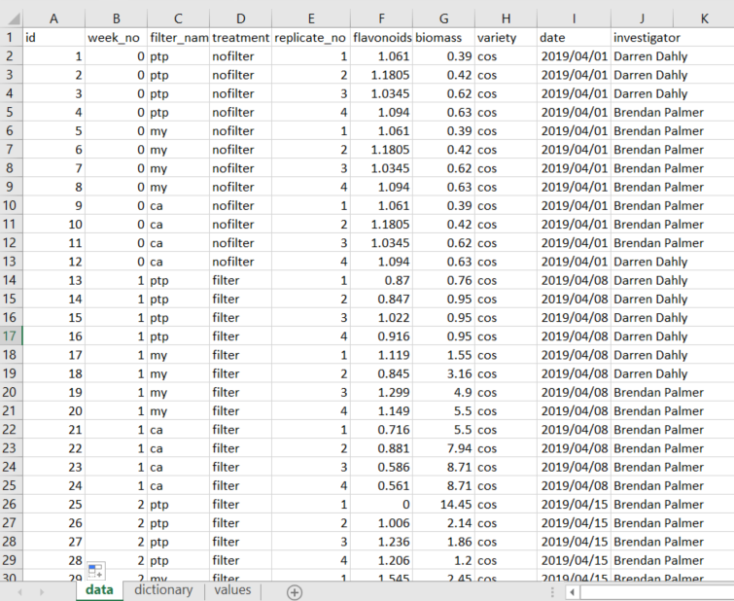
Less stress, more success
Notes:
You’re doing this work anyway
Do it smart

Slide 30
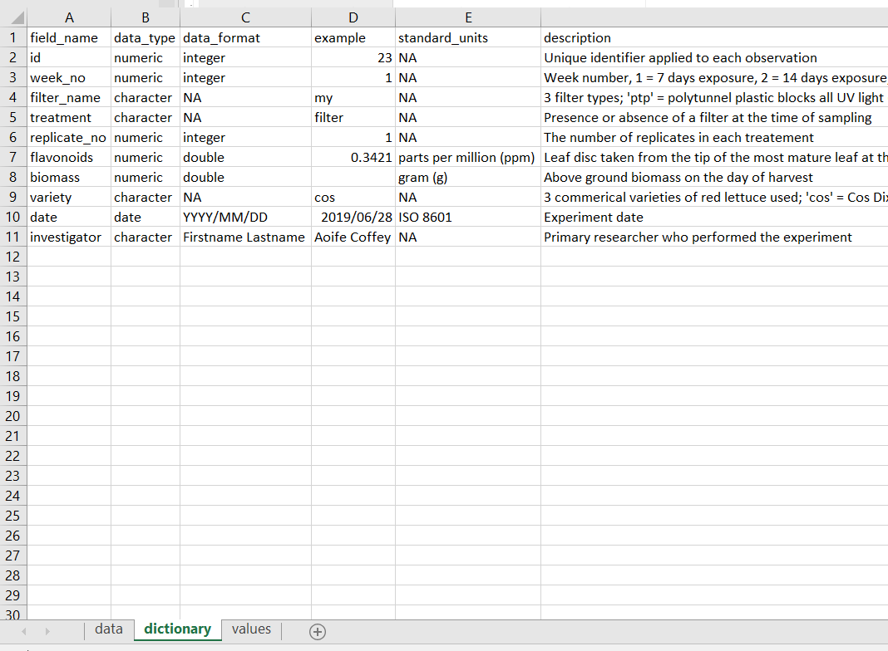
Less stress, more success
Notes:
This applies to any software you use in the future

Slide 31
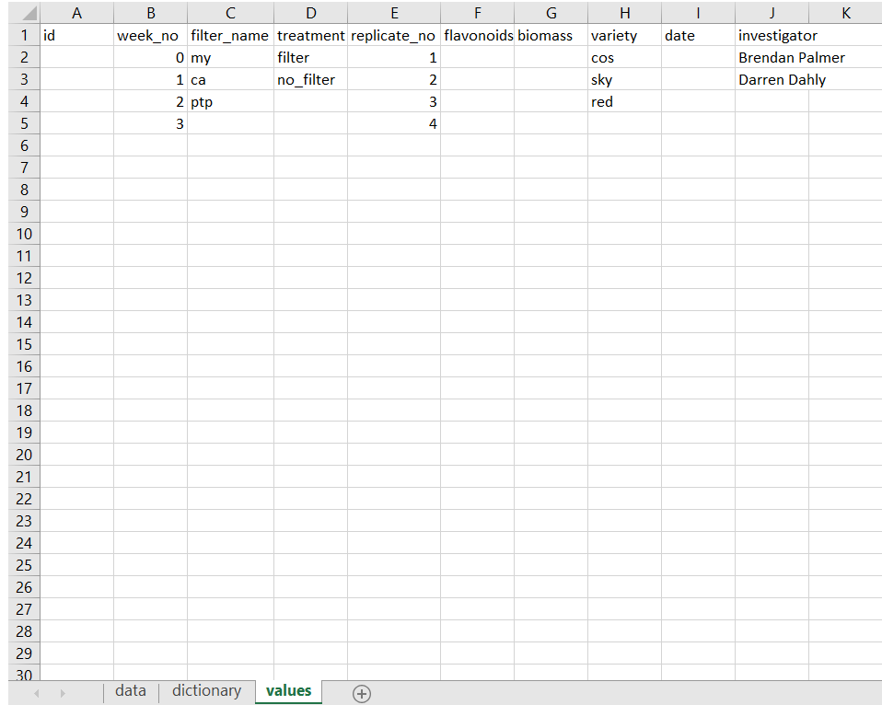
Less stress, more success
Notes:
This applies to any software you use in the future

Slide 32
Less stress, more success
Notes:
This applies to any software you use in the future

Slide 33





The movement towards FAIR data
F + A + I = R
Findable
Accessible
Interoperable
Reusable
(Replicable,
Reproducible)

Slide 34
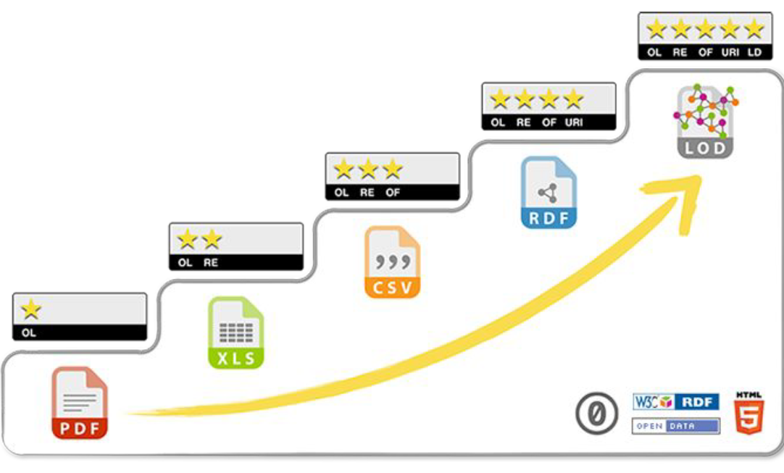
Three main take home messages
FAIR is not prescriptive
Varying levels of FAIR
Use of existing tools
Image: 5 ★ OPEN DATA

Slide 35
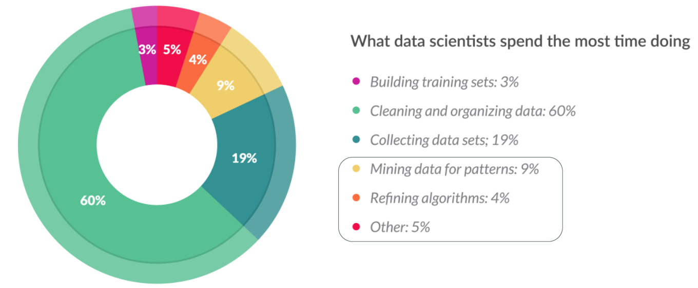
Resources are being wasted by not doing this
CrowdFlower (2016) Data Science Report
Notes:
And the funders are becoming aware of this

Slide 36


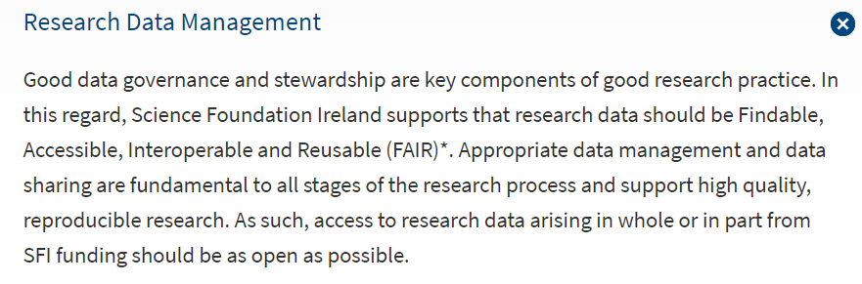
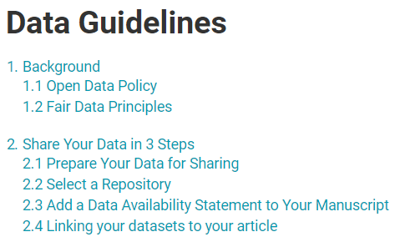




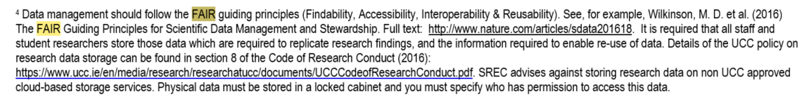
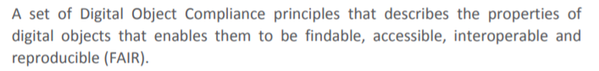
FAIR is a part of our life now!

Slide 37







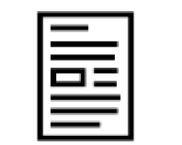
What does this allow us to do?
analysis
data
raw_data
README.txt
codebook
project.Rproj
scripts
project.Rmd
plots
README.md
tables
A.N. Other
OSF / GitHub
Project DOIs
Data DOIs
data
raw_data
Publications
README.txt
README.md
codebook
LICENCE
scripts

Slide 38
What does this allow us to do?
OSF / GitHub
Project DOIs
Data DOIs
data
Open Access
Publications
README.txt
README.md
codebook
LICENCE
scripts

Slide 39
What does this allow us to do?
OSF / GitHub
Project DOIs
Open Data
Data DOIs
data
Open Access
Publications
README.txt
README.md
codebook
LICENCE
scripts

Slide 40
What does this allow us to do?
Open Source
OSF / GitHub
Project DOIs
Open Data
Data DOIs
data
Open Access
Publications
README.txt
README.md
codebook
LICENCE
scripts

Slide 41
What does this allow us to do?
Open Materials
Open Source
OSF / GitHub
Project DOIs
Open Data
Data DOIs
data
Open Access
Publications
README.txt
README.md
codebook
LICENCE
scripts

Slide 42
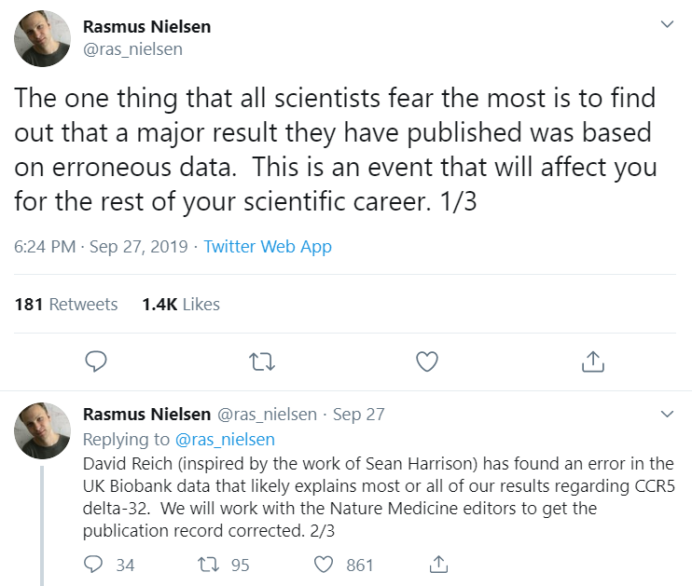

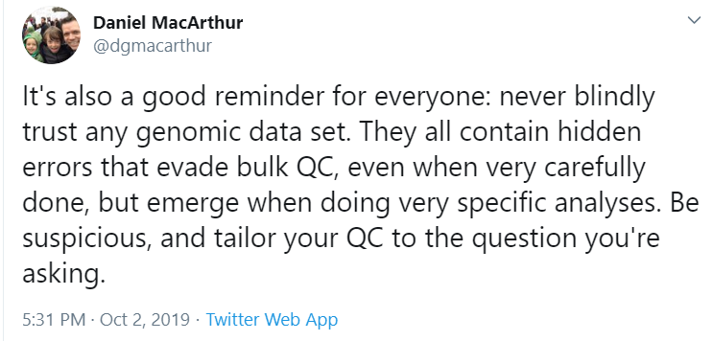
Mistakes can still happen
Notes:
Nielsen and colleagues reported that ∆32/∆32 individuals have a significantly higher death rate than the other two genotypes (
CCR5 is a co-receptor used by HIV therefore plays an essential role in HIV pathogenesis
CCR5-delta 32 is know to hampers HIV's ability to infiltrate immune cells

Slide 43
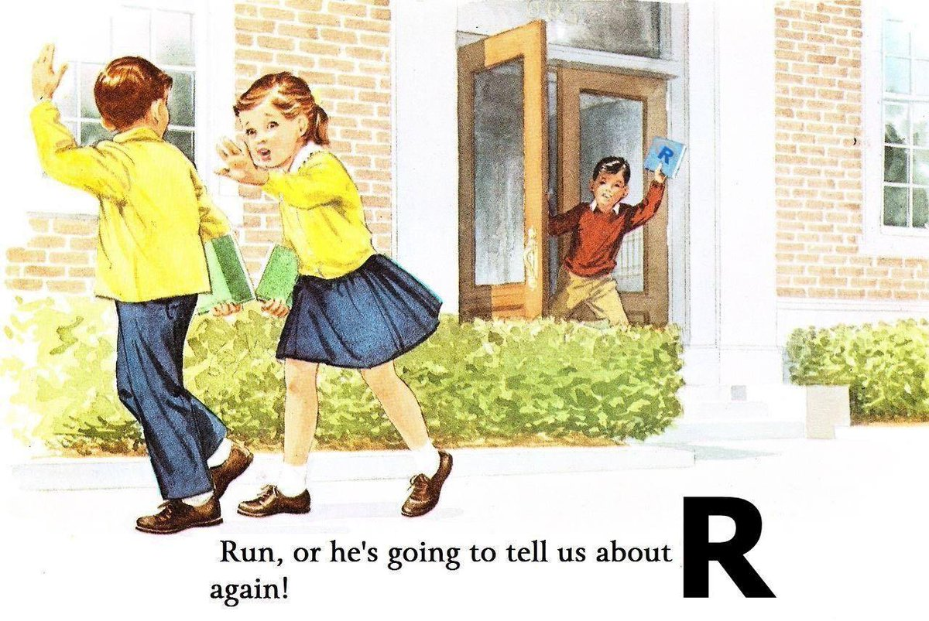
The key is they can be detected and corrected!
Notes:
Nielsen and colleagues reported that ∆32/∆32 individuals have a significantly higher death rate than the other two genotypes (
CCR5 is a co-receptor used by HIV therefore plays an essential role in HIV pathogenesis
CCR5-delta 32 is know to hampers HIV's ability to infiltrate immune cells

Slide 44









Acknowledgements
Notes:
Remember to tell them about the questionnaire to be circulated next week

